Slide 1
BASICS OF COMMUNICATION
Meaning, Process, Forms & Types

Slide 2
Imagine a situation that you are hungry. What will you do to make your mother serve you food?

Slide 3
You are in a crowded bus and somebody steps on your foot. What will you do to let the person know ?

Slide 4
You went to your boss with a cost saving idea. He was convinced verbally, but the nonverbal cues: avoiding eye contact, sighing, scrunched up face, etc. indicate something different.

Slide 5
MEANING
Definition of communication (Merriam Webster's Dictionary)
1a : a process by which information is exchanged between individuals through a common system of symbols, signs, or behavior also : exchange of information
b : personal rapport
2a : information communicated : information transmitted or conveyed
b : a verbal or written message The captain received an important communication.
.
Note-
Communication is simply the act of transferring information from one place, person or group to another.
Keith (1993) defines communication as "the transfer of information and understanding from one person to another person”.
It is a way of reaching others with facts, ideas, thoughts and values.
It is a bridge of meaning among people so that they can share what they feel and know.
By using this bridge, a person can cross safely the river of misunderstanding that sometimes separates people."

Slide 6
The Communication Process
Sender
Encoding
Channel
Noise
Message
Barrier
Feedback
Channel
Decoding
Receiver

Slide 7
Example
Teacher
I need students to know that they cannot bully each other.
Air, face to face
Squealing sound from PA system.
“Bullying is unacceptable behavior. You will be punished for bullying.”
Being in athletics and not hearing announcements.
Raj asks if tripping someone counts as bullying?
Public Address System
I wonder if that includes tripping someone for fun…
Students

Slide 8
Forms of Communication
Email
Letter
Memo
Written Report
Face-to-Face communications
Meetings
Audio-Visual communication

Slide 9
Types of Communication
Kinesics
Advantages : Quick Feedback, Formal/Informal
Disadvantages: Inability in Deep Thinking
Oral: Speech, Telephonic Conversations, etc.
Paralinguistics
1. Verbal
2. Non- Verbal
Types
Proxemics
Written: Emails, Letters, WhatsApp, Twitter, etc.
Chronemics
Advantages : Editing options, Documentation, Feedback
Disadvantages: Lacks in Instant Feedback, Time Consuming

Slide 10

PARALINGUISTICS
Speed/Tempo
Rhythm
Volume
Pitch
Quality
Tone

Slide 11
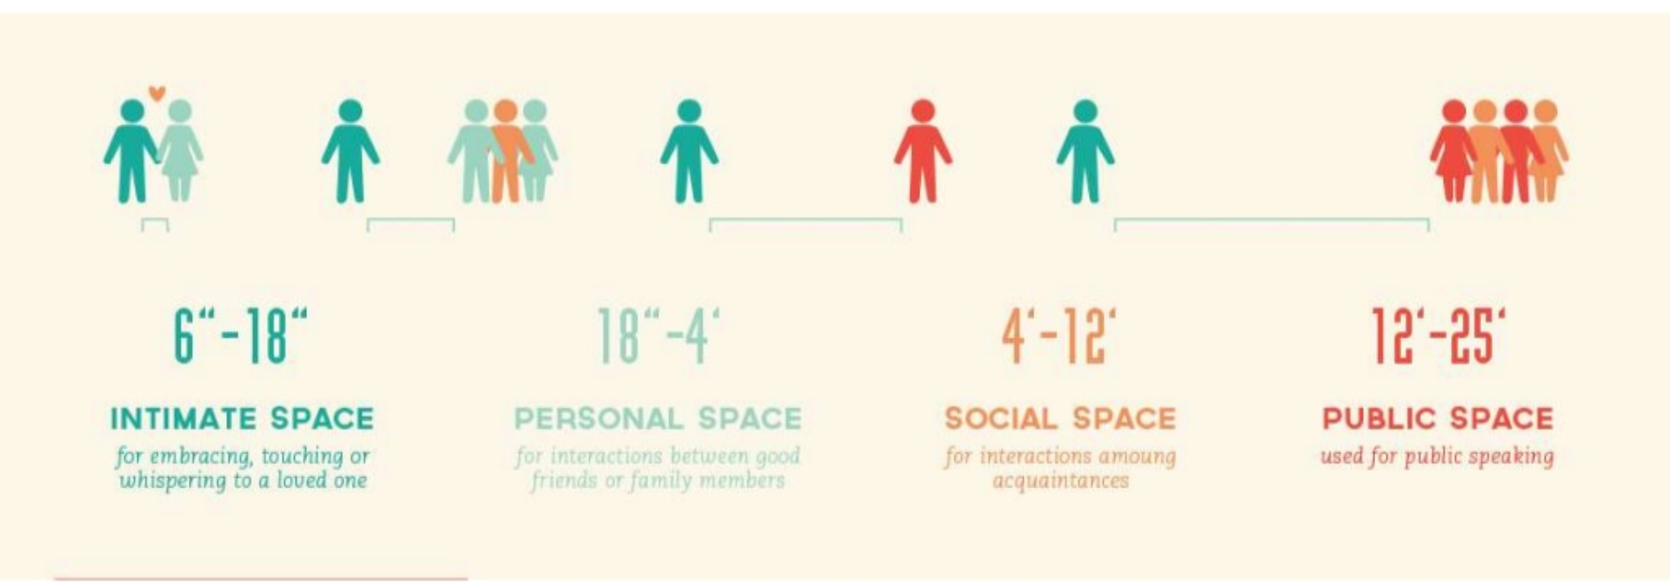
PROXEMICS

Slide 12
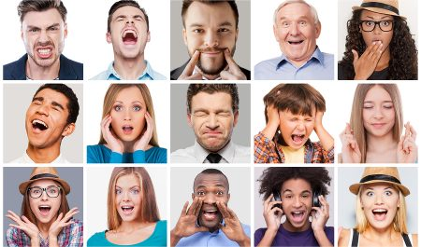
KINESICS

Slide 13
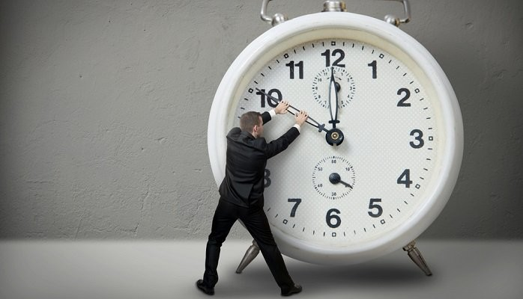
CHRONEMICS
The study of time management and its role in communication is called Chronemics.
Managing time reflects a professional etiquette.
Punctuality reflects individual’s seriousness.

Slide 14
Advantages
1. Efficiency
2. Permanent Record
3. Discipline
4. Confidentiality
5. Reliability
Disadvantages
1. Authoritarian System
2. Rigidity/Inflexibility
3. Time Consuming
4. Lack of Initiative
3. Formal
4. Informal
Advantages
Alternative System
Open Endedness
Improvement of Relations
Providing Recommendations
Disadvantages
Distortion
Lack of Reliability
Incomplete Information
Possibility of Rumors
Misunderstanding

Slide 15
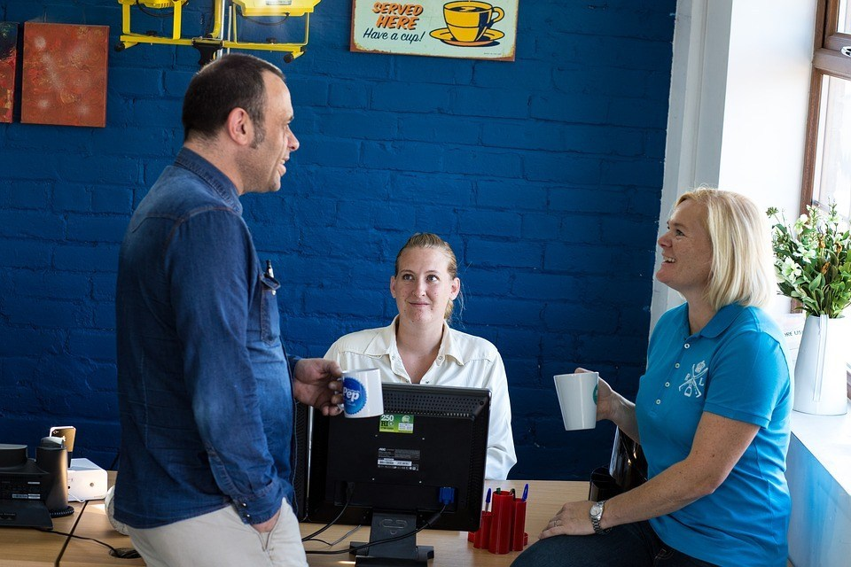
Grapevine Communication
Informal Channels transmit official news through unofficial and informal communicative interactions.
# According to Bovee and Others, “Grapevine is an informal interpersonal channel of information not officially sanctioned by the organization.
# In the opinion of R.W. Griffin, “The grapevine is an informal communication network that can permeate an organization.”
# Newstrom and K. Davis said, “Grapevine is an informal system that arises spontaneously from the social interaction of the organization.”

